Slide 1


Name: IBRAHIM MUSTAFA ALI WDATALLA
Date: Aug/6/2024

Slide 2

Outline
Executive Summary
Introduction
Methodology
Results
Conclusion
Appendix

Slide 3
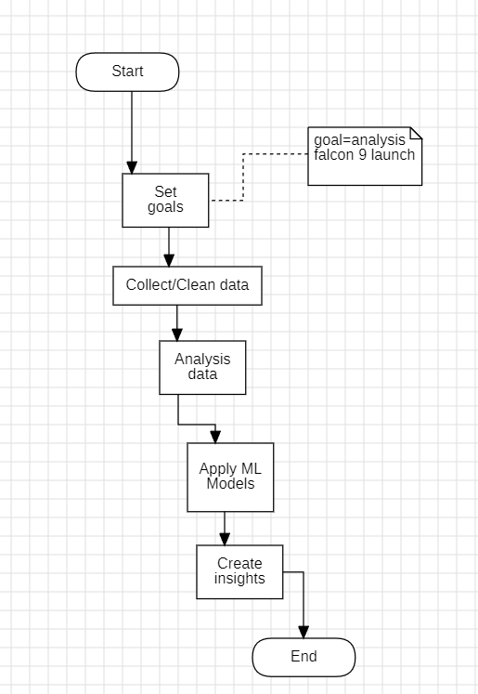
Summary of methodologies:
Executive Summary
Quick Summary:
In falcon 9 most successful Launch Site in KSC LC-39A.
Tree is the highest accuracy with 88% .
We build interactive dashboard to visualize data.
We map the successful/frailer launch in location using Folium.
3

Slide 4

Introduction
Space X advertises Falcon 9 rocket launches on its website with a cost of 62 million dollars; other providers cost upward of 165 million dollars each, much of the savings is because Space X can reuse the first stage. Therefore, if we can determine if the first stage will land, we can determine the cost of a launch. This information can be used if an alternate company wants to bid against space X for a rocket launch.

Slide 5

Section 1

Slide 6
Methodology
Executive Summary
Data collection methodology:
Search on Wikipedia data about SpaceX rocket
Perform data wrangling
We extract/understand which rocket we use and prepare columns
Perform exploratory data analysis (EDA) using visualization and SQL
After applying magic line in lab, we convert data in database locally and Visualized a lot for column that we saw understand from EDA
Perform interactive visual analytics using Folium and Plotly Dash
Apply the location on folium & map them in interactive dashboard
Perform predictive analysis using classification models
Apply four machine learning model to predict success/failure landing

Slide 7
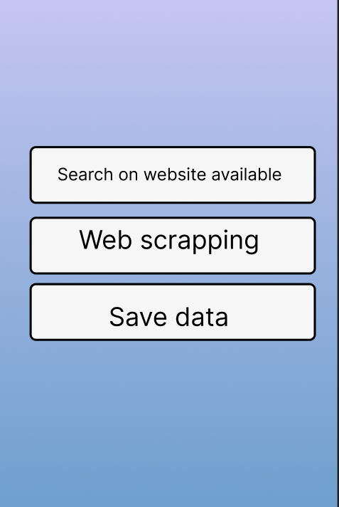

Data Collection
After search for website that help us to get data on, we got Wikipedia data and SpaceX api then we clean it and save in database locally.
Start
Extract data from SpaceX
Save data on database locally
Apply EDA
END

Slide 8
Data Collection – SpaceX API
Start
Flowcharts of SpaceX API calls:
Github SpaceX API calls
imports necessary library like requests , pandas , datetime
requests.get(spacex_url)
check request sates
=200
take Jason url site from IBM file
!=200
Normalize data
Print error
save it as csv
END

Slide 9
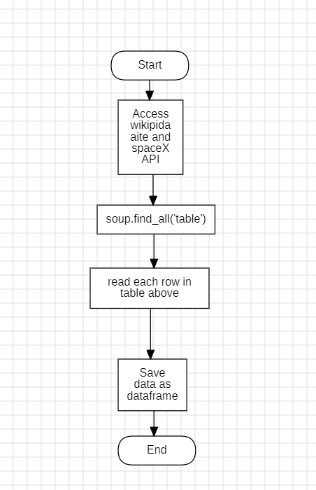
Data Collection - Scraping
Scrapping phase:
GitHub source code.

Slide 10
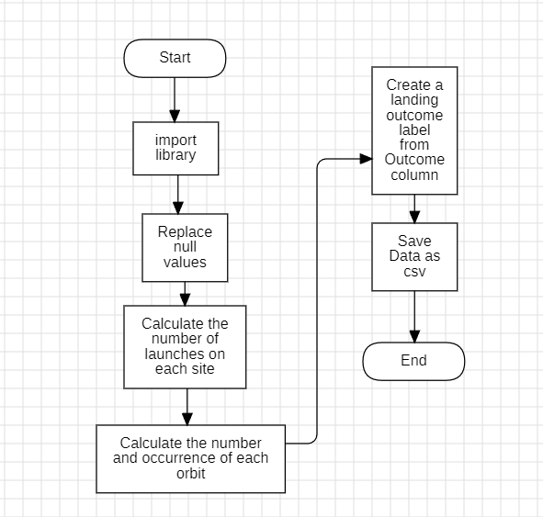
Data Wrangling
As you can see, we from flowchart we replace Null and calculate addition columns
GitHub Page

Slide 11
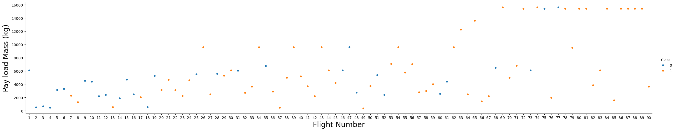
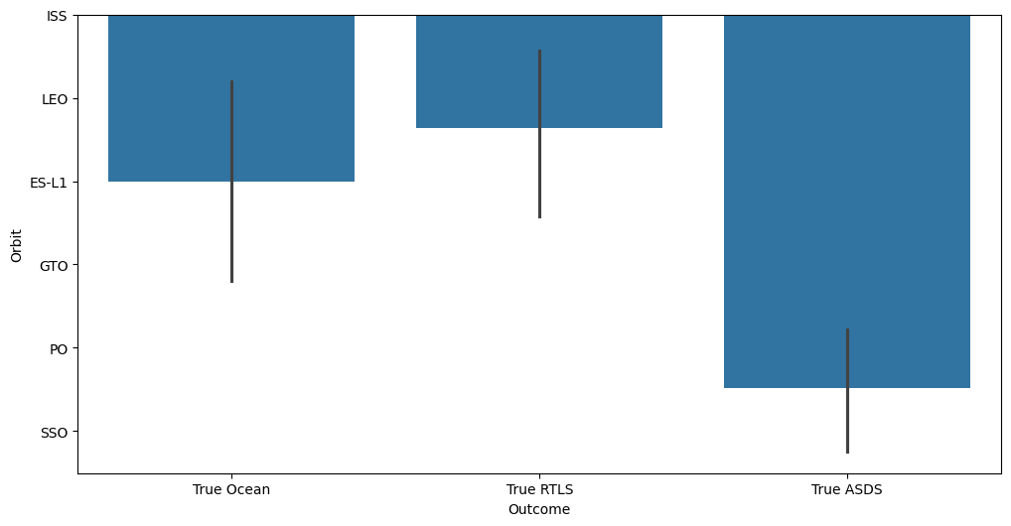
EDA with Data Visualization
First chart drowned to know what is optimum payload mass (successful)
Second chart to know the successful orbit
There is many more on Github page

Slide 12
EDA with SQL
Some SQL queries performed:
%sql create table SPACEXTABLE as select * from SPACEXTBL where Date is not null
%sql select * from SPACEXTABLE limit ;
%sql select * from spacextable where Launch_Site like 'CCA%' limit 5;
%sql select sum(PAYLOAD_MASS__KG_) from spacextable where Customer like 'NASA (CRS)’ ;
%sql select avg(PAYLOAD_MASS__KG_) from spacextable where Booster_Version like 'F9 v1.1' ;
For more visit, our github

Slide 13
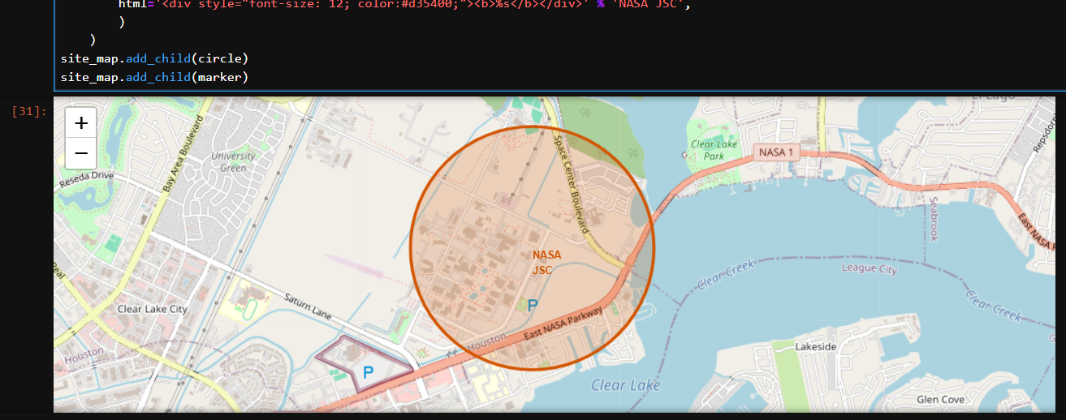
First, we crate “Folium.map” then we create “folium.Circle” to draw circle around the map i.e.:
This object can be holding child(Marker) ,, well explained in next slide.
For more info visit our GitHub.
Build an Interactive Map with Folium

Slide 14
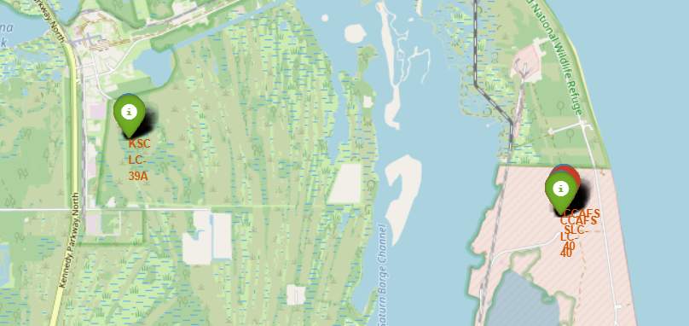
Second , we crate “Folium. MarkerCluster” to hold red mark “unsuccessful land” and green “successful land”.
For more info visit our GitHub.
Build an Interactive Map with Folium
14

Slide 15
Build a Dashboard with Plotly Dash
We draw pie chart to know what successful land are.
We draw pie chart to know what is the most successful land location.
We draw slider to let the owner assign what kg should used
We draw scatter plot to visualize the kg to successful /unsuccessful land.
For more info visit our GitHub.

Slide 16
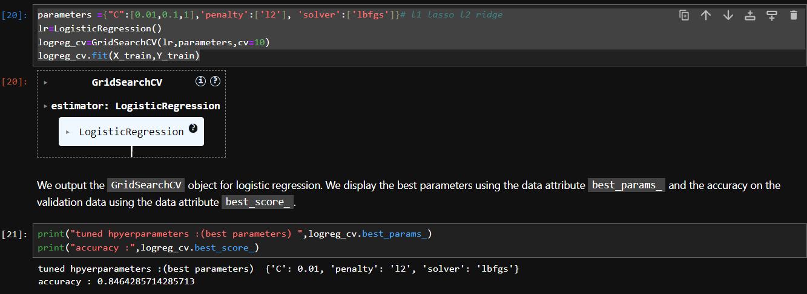
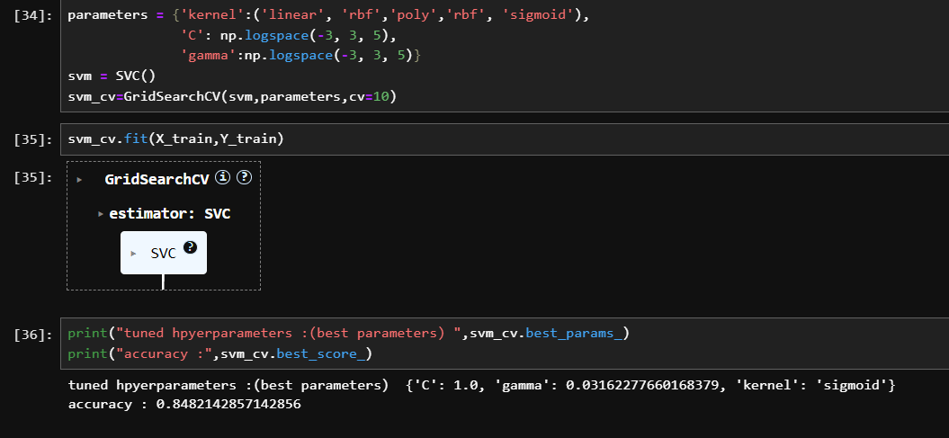
Predictive Analysis (Classification)
We used a lot of model and choose the best accuracy between them
Sample of models:
For more info visit our GitHub.

Slide 17

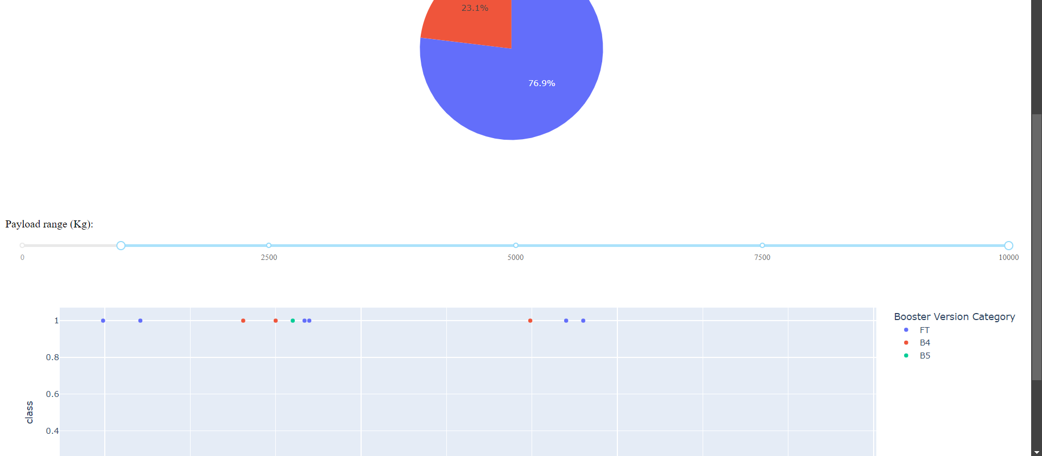
Results
Exploratory data analysis results:
Interactive analytics demo in screenshots
Predictive analysis results
The data is cleaned
87 % accuracy

Slide 18

Section 2

Slide 19
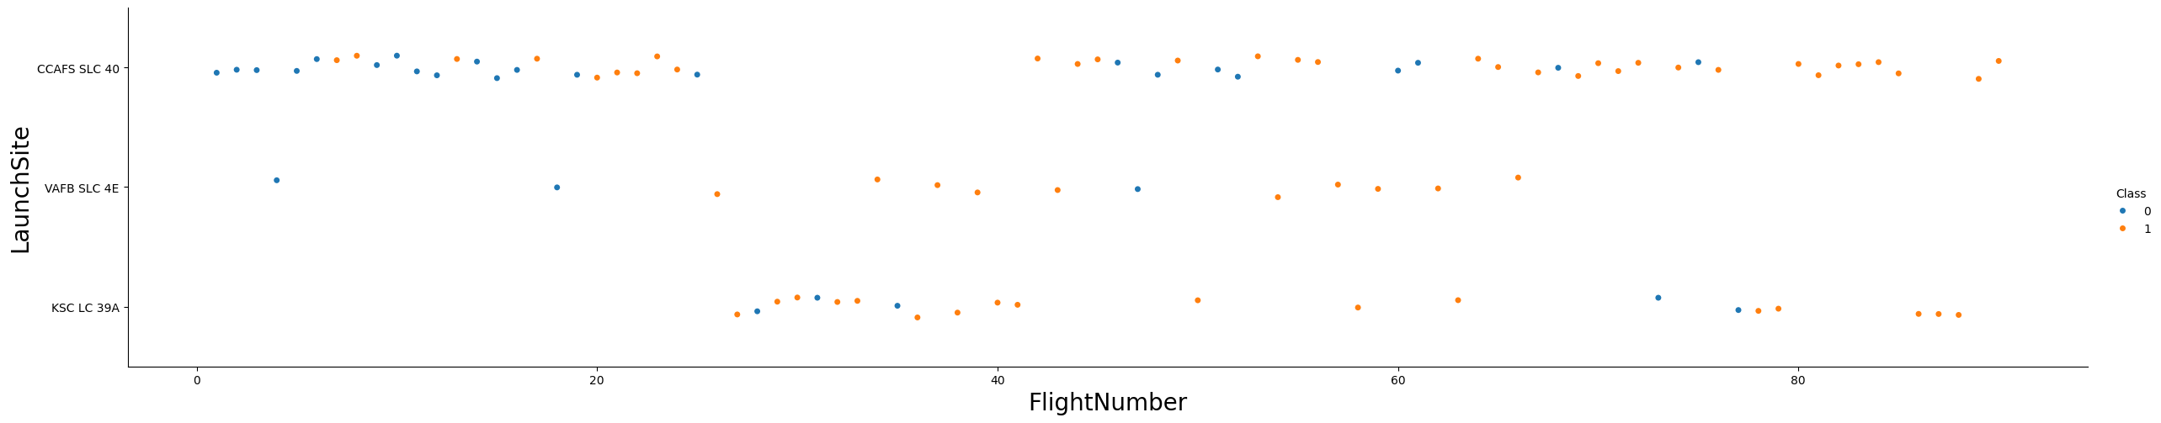
Flight Number vs. Launch Site
Scatter plot of Flight Number vs. Launch Site
The flight number 40+ on CCAFS SLC 40 have a lot of successful land

Slide 20
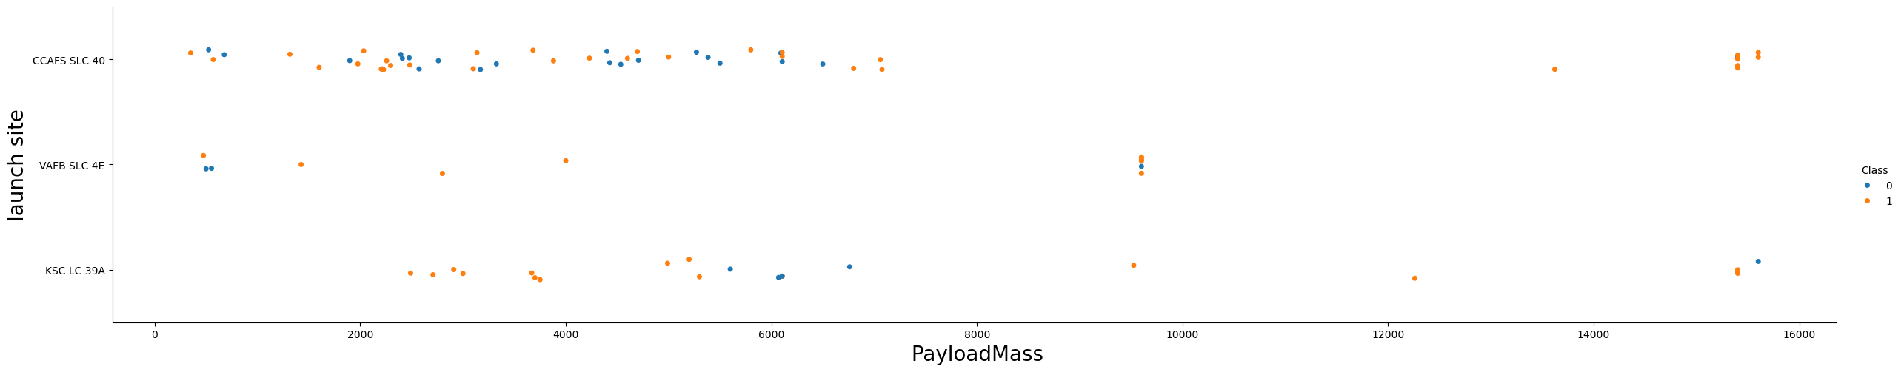
Payload vs. Launch Site
Scatter plot of Payload vs. Launch Site.
When the mass more than 8000 kg there less data but CCAFS SLC 40 seems promising.

Slide 21
Success Rate vs. Orbit Type
True ASDS is most successful in PO orbit and under it.

Slide 22
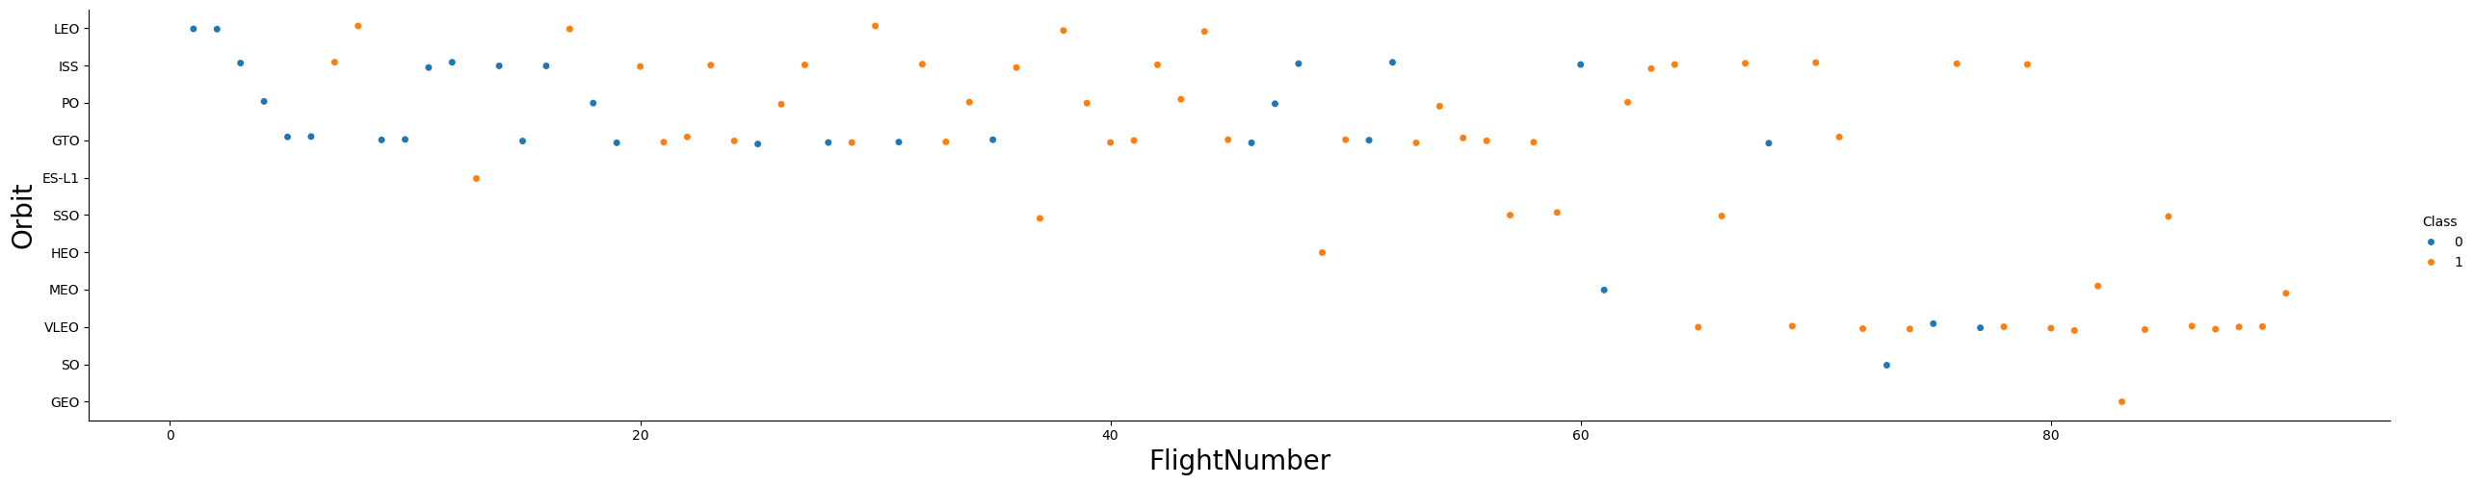
Flight Number vs. Orbit Type
Most data range from SSO orbit and LEO orbit.

Slide 23
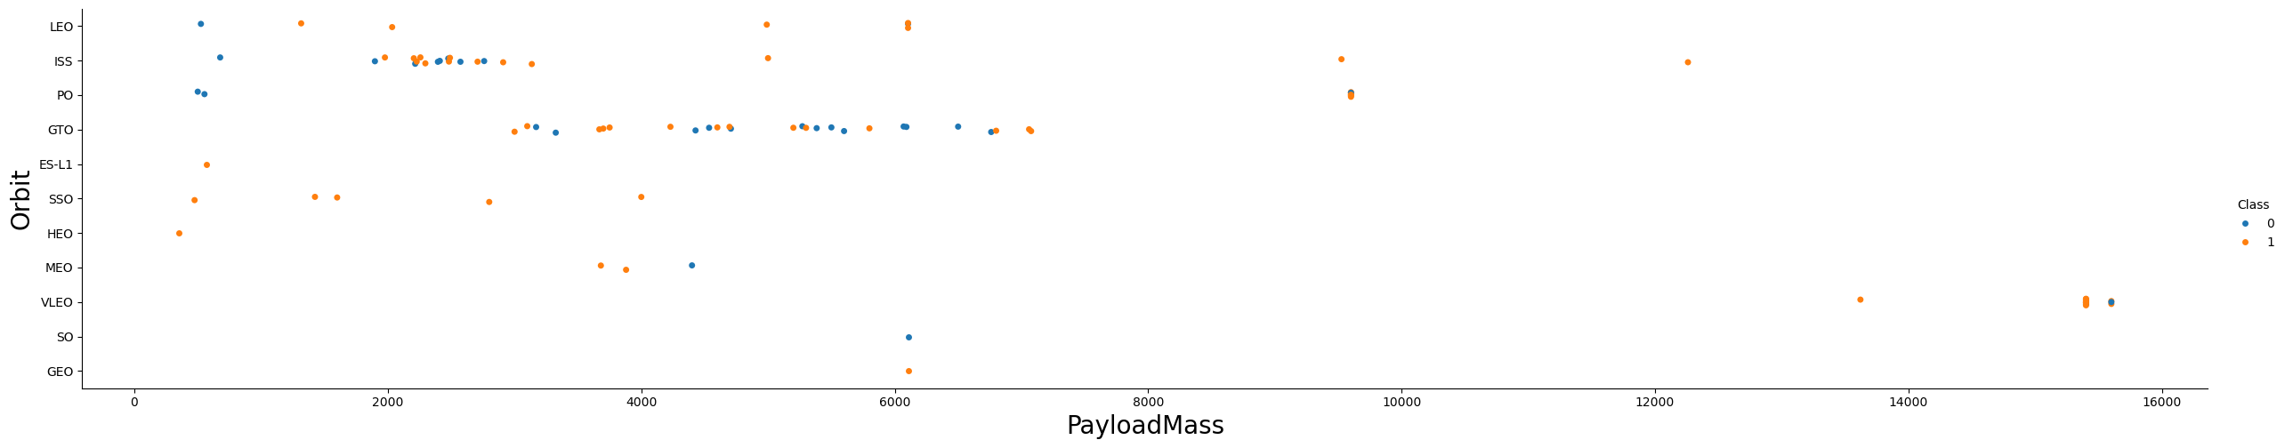
Payload vs. Orbit Type
Payload have 1400 kg + access VLEO orbit.

Slide 24
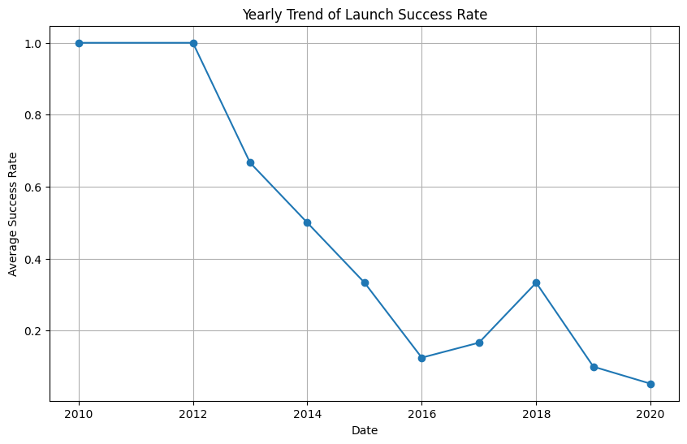
Launch Success Yearly Trend
There is spark in 2018 because there was a lot of research.

Slide 25
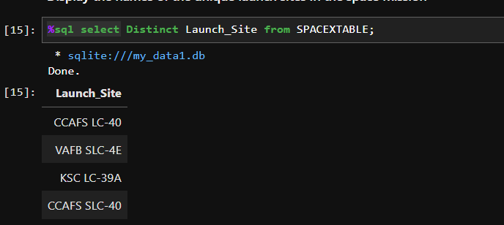
All Launch Site Names
There is five unique Launch site.

Slide 26
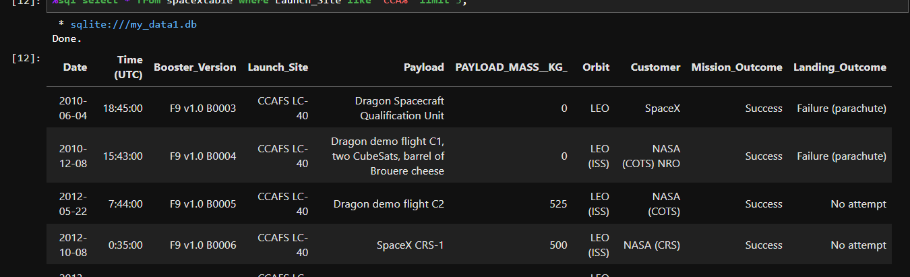
Launch Site Names Begin with 'CCA'
Sites begin with `CCA`:

Slide 27
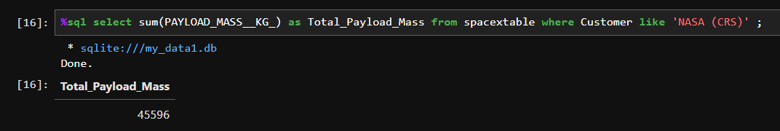
Total Payload Mass
45596 kg

Slide 28
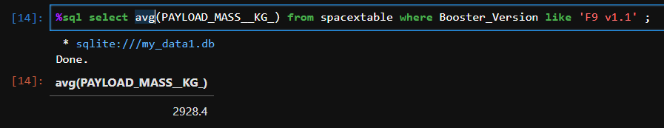
Average Payload Mass by F9 v1.1
2928.4

Slide 29
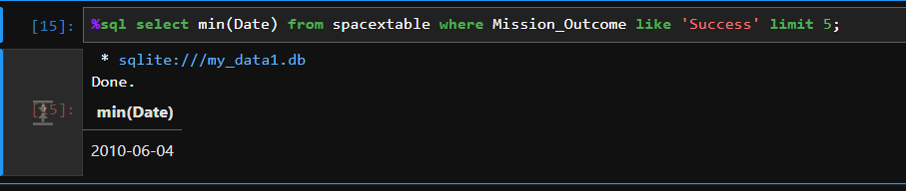
2010-06-04
First Successful Ground Landing Date

Slide 30
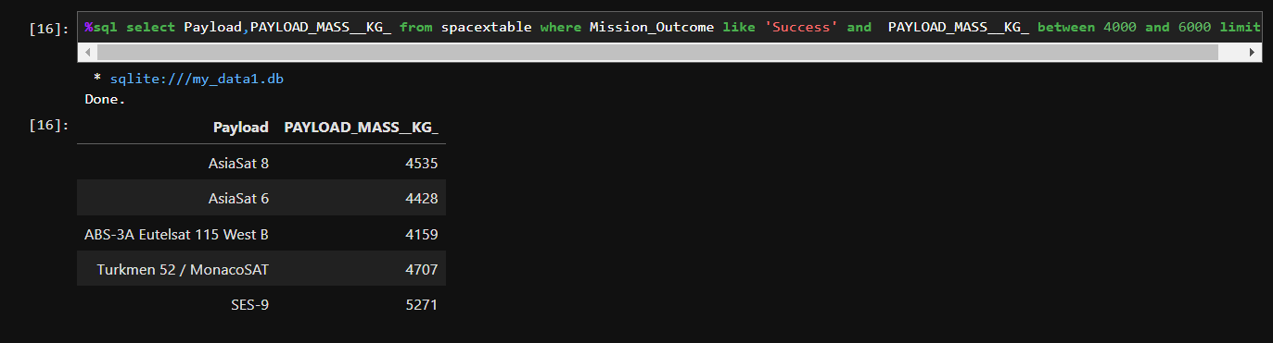
Successful Drone Ship Landing with Payload between 4000 and 6000

Slide 31
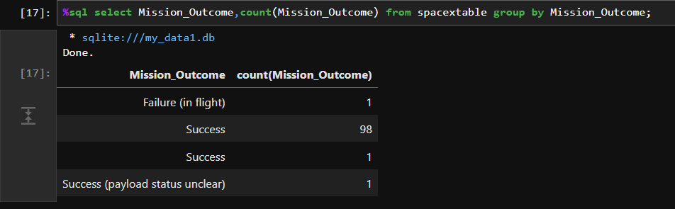
Total Number of Successful and Failure Mission Outcomes
101

Slide 32
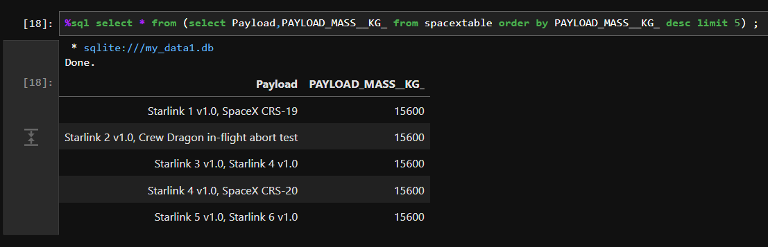
Boosters Carried Maximum Payload

Slide 33
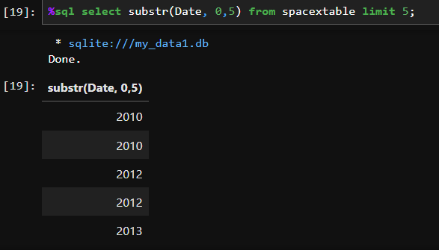
Failed landing outcomes in drone ship, their booster versions, and launch site names for in year 2015:
2015 Launch Records

Slide 34
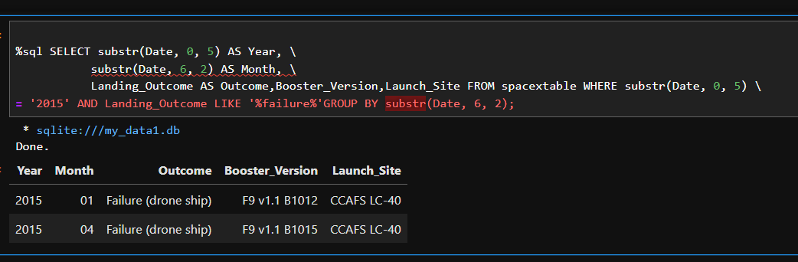
Rank Landing Outcomes Between 2010-06-04 and 2017-03-20

Slide 35

Section 3

Slide 36
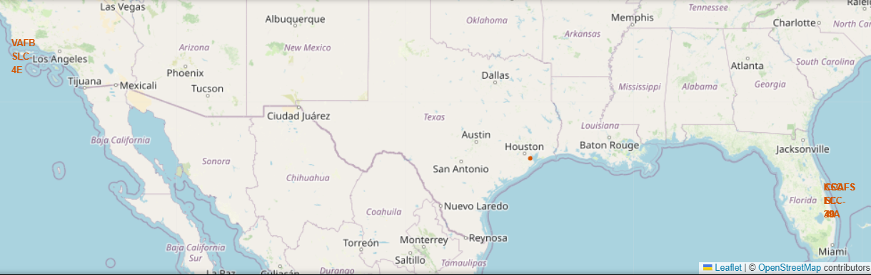

All launch sites on a map
As shown in Folium map the two places that rocket landed / lunched is on Los Angeles and Florida

Slide 37
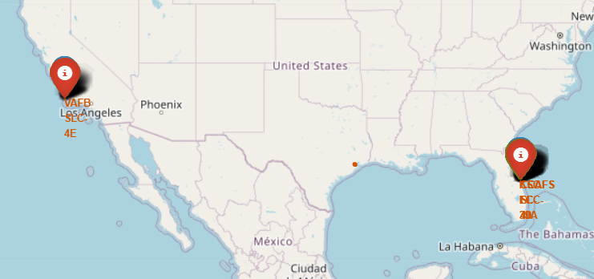
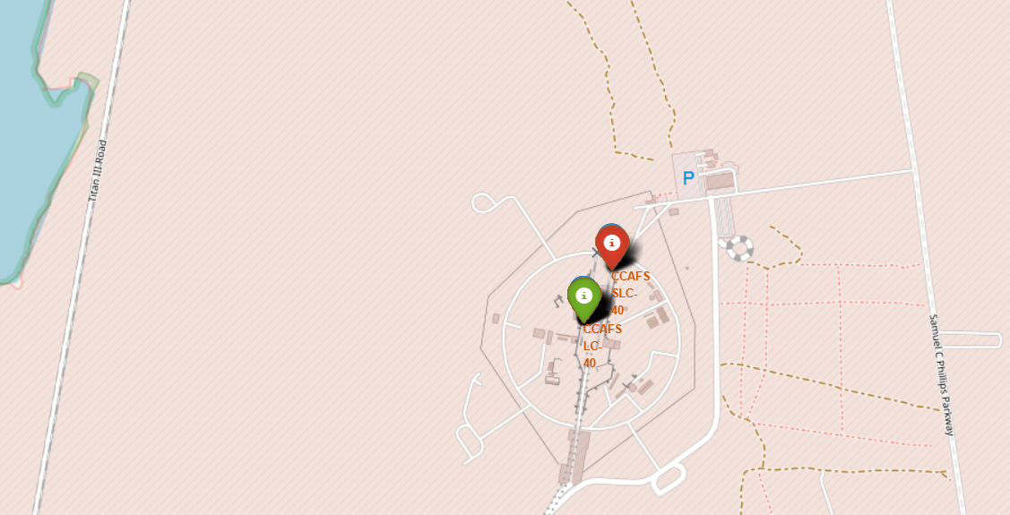
Success/failed launches for each site on the map
We mapped failed launch with Red marks and green launch for successful in the map by using MarkerCluster() function

Slide 38
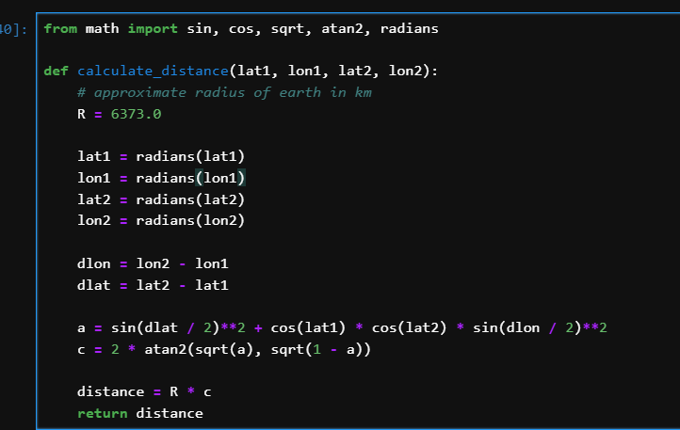
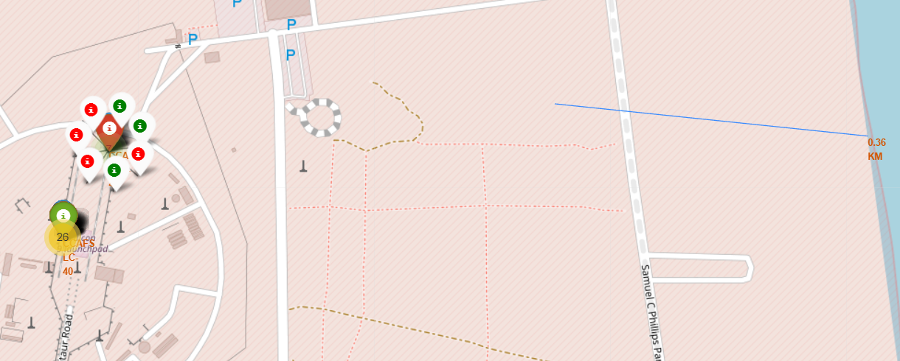
Calculate the distances between a launch site to its proximities
We used to calculate distance to calculate distance between two points in earth in this map below I used random number, but the blue line could connect between two points if we have latitude and longitude .

Slide 39

Section 4

Slide 40
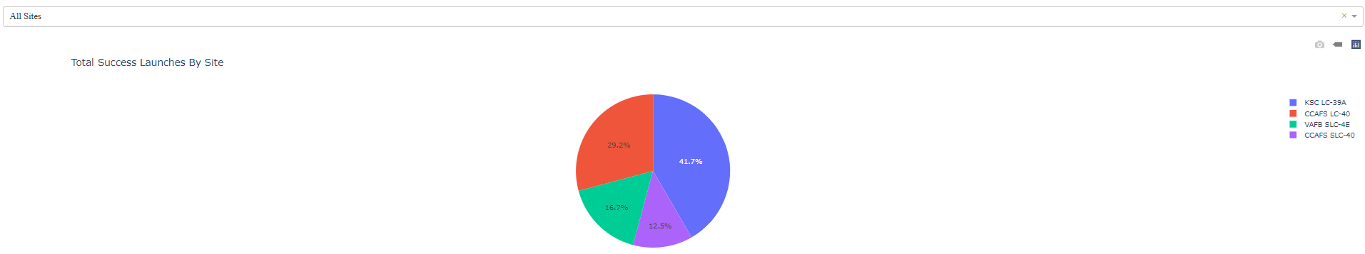
Launch success count for all sites
The majority successful in KSC LC 39A
40

Slide 41
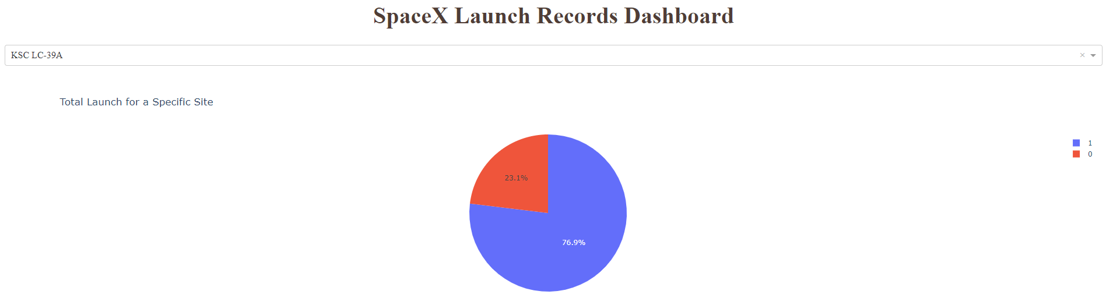
Site that has highest launch success rate
KSC LC-39A

Slide 42
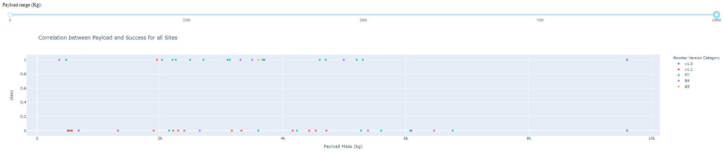
Payload vs. Launch Outcome scatter plot for all sites:

Slide 43

Section 5

Slide 44
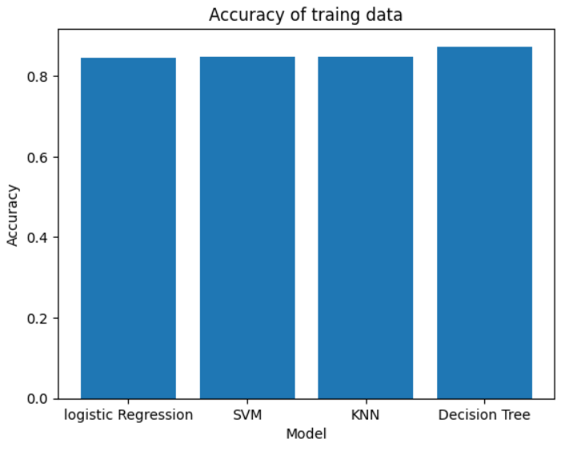
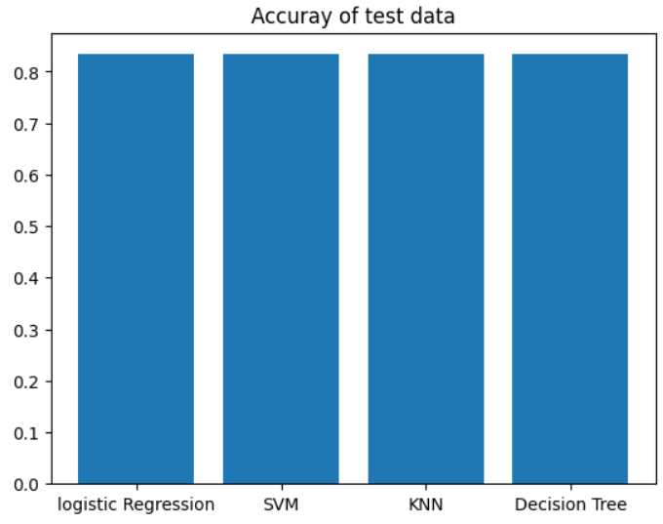
Classification Accuracy
The highest accuracy is 88% on Decision Tree.

Slide 45
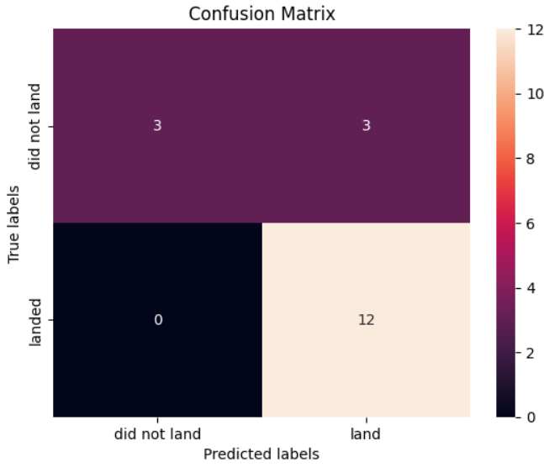
Confusion Matrix
The true positive is 3 and the false positive is 12
So, its very good since the majority is correct.

Slide 46

Conclusions
In falcon 9 most successful Launch Site in KSC LC-39A.
Tree is the highest accuracy with 88% .
We build interactive dashboard to visualize data.
We map the successful/frailer launch in location using Folium.

Slide 47
Appendix
%sql line
Confusion matrix
Author Git-hub

Slide 48

Thank you.

